Slide 1

Marketing Plan Presentation
Felicia L. Jones-Shaw
AET/552
May 23, 2016
Dr. Dennis Morrow
Notes:
This presentation is an outline of the Marketing Plan completed by Team B, which consists of Erin Ashley, Jennifer Boutwell, Felicia Jones-Shaw, Deariesha Mack, and Ellen Myers.

Slide 2

Happiness is Movement
American Beverage Association (2016)
  Non-Alcoholic Beverage Industry
    Economic Impact
      More than $169 Billion
      240,000 Jobs
Increasingly health-conscious audience
  We’ve stayed true to our original formula
  Introduced Diet Coke and other sugar-free products
Notes:
In recent news, the American Beverage Association (2016) reports that the non-alcoholic beverage industry, including regular and diet soft drinks, has a direct economic impact with more than $169 billion, and providing nearly 240,000 jobs. The Coca-Cola Company has established itself as a competitive and profitable company in the beverage industry for well over a century. Even with an increasingly health-conscious audience, we have stayed true to our original formula, while finding other ways to promote our beverages and stay relevant and up-to-date with current trends generation after generation.

Slide 3
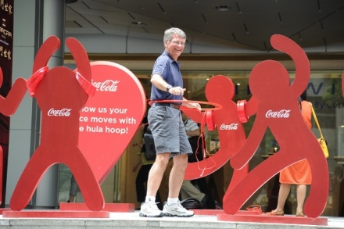
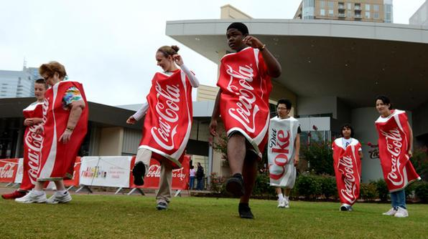
Health and Wellness Initiative
Our goal is to help employees
  Achieve and maintain healthier lifestyles
  Increase productivity
  Lower health care premiums
Notes:
In keeping in line with our Happiness is Movement campaign, we are looking to implement a new health and wellness initiative for our employees. Diet and physical fitness are critical factors in helping employees achieve and maintain a healthier lifestyle and increase productivity. This initiative will improve the overall public image of the Coca-Cola Company, lower health care premiums for employees, and preserve the relevance of the products that have become a cultural norm in many parts of the globe.

Slide 4
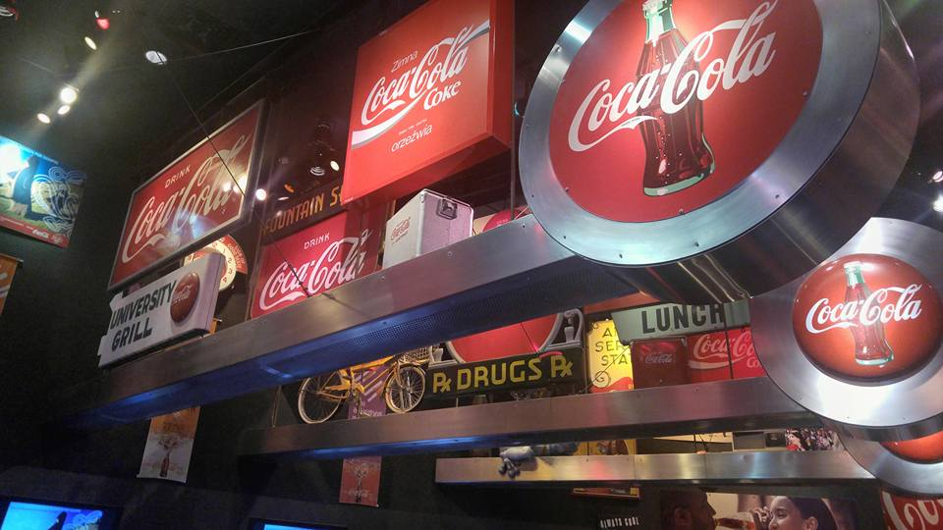
Phase I
Notes:
First presented at a soda fountain in Atlanta, Georgia in 1886, Coca-Cola has evolved from its original inception as a stand-alone cola product to encompass multiple brands with offices and distribution centers worldwide. Throughout the years, one area where Coca-Cola remains consistent is its dedication to Coca-Cola employees and their families.
Employee benefits include health, vision and dental insurance plans, long-term and short-term disability, accident insurance, flexible spending accounts, tuition reimbursement plan, discounts for local health club memberships, retirement plans, and more. As a large employer, Coca-Cola is keenly aware of the rising costs of healthcare and therefore seeks to improve the lives of its employees through the utilization of wellness programs that include nutritional information and benefits, non-smoking programs, weight loss programs, and improved access to and participation in exercise.
As part of this program, Coca-Cola is establishing an employee fitness center that will provide Coca-Cola our staff easy, affordable access to modern gym equipment, coaches, team and individual sports, and a wide array of exercise classes taught by certified health professionals.
The total budget for this project is $949,435,200. The proposed budget for the project is based on the projected 60% participation rate; the Coca-Cola Company has an estimated 700,000 employees globally, so we are expecting participation from at least 420,000 employees (The Coca-Cola Company, 2016d). The health and wellness program will cost employees a $25 monthly membership fee. However, employees who participate will be saving $31.80 on health insurance premiums monthly. In addition to those saving, the company will also save on the employer contribution to health insurance premiums, along with a projected 15% decrease in workman's compensation claims, and increased revenues from improved productivity. These savings along with the $25 monthly membership fee will fund the health and wellness program and create a profit so more improvements can be made in the future.

Slide 5

Phase II
Improve the lives of employees through:
  Utilization of wellness programs
    Nutritional information and benefits
    Smoking cessation, weight-loss, and stress management
  Lifestyle or behavioral coaching
  On-site fitness center
Notes:
As we have seen in the media, statistical reports, or just looking around us, the overall health of the American population is worsening. The Wellness Council of America (2011) points out that as baby boomers get older, the health status of the American workforce will continue to decline, which is bad for employees and their employers. The Center for Disease Control and Prevention reports (2015):
- More than one-third of U.S. adults are obese.
- Obesity-related conditions include heart disease, stroke, type 2 diabetes, and certain types of cancer.
- The estimated annual medical cost of obesity in the U.S. was $2.8 trillion in 2012, more than any other industrialized nation.
- Medical expenses for people who are obese were more than $1429 higher than those of average weight.
According to health-care statistics from The Wellness Councils of America, “Preventable illnesses make up approximately 70 percent of all disease and associated health-care costs," (Huddleston, 2000, para. 6). Organizations and their employees can decrease health care costs by establishing and participating in wellness programs with a focus on nutrition, fitness, and exercise. Over 378 peer-reviewed studies show workplace wellness programs improve employee health and underlying health conditions, which leads to healthier living.
There are many benefits to an organization offering their employees a corporate fitness center like lower insurance premiums, reduced absenteeism, increased productivity, and convenience (Miller, 2015). As identified by Fielding & Piserchia (1983), using the workplace as a vehicle to promoted healthy living is advantageous because a vast majority of people spend a significant time at work. Providing them with an on-site gym is a great investment to encourage one another to make the right modifications to lead healthier lifestyles. Implementing a project of this magnitude draws attention to many stakeholder groups for various reasons in promoting workplace health, diet, and physical activity.

Slide 6


Phase III
Creative Strategy
  Focus on 5 key areas
    Establish a Culture of Wellness
    Identification of Goal and Mission
    On-Site Fitness Centers
    Offering Healthy Food Choices
    Smoking, Weight Loss, and Stress Management Programs
Notes:
Our message centers on helping our employees achieve a work and life balance by focusing on healthy living from the inside out. We want our workforce to learn about and understand how living healthier lifestyles can help them be more productive in the workplace and at home. Through the implementation of our wellness initiative, our staff members will gain knowledge on how to improve and maintain good health through diet and exercise to lead to a better quality of life. This initiative will focus on five key phases: 1) Establish a Culture of Wellness; 2) Identification of Goal and Mission; 3) On-Site Fitness Centers; 4) Offering Healthy Food Choices; and 5) Smoking, Weight Loss, and Stress Management Programs.
Culture of Wellness. The leaders of the Coca-Cola Company must lead by example by being engaged and excited about establishing the wellness program. We will enroll and participate in the promotion and delivery of our “Happiness is Movement” wellness campaign.
Identification of Goal and Mission. We will clearly identify the purpose and mission of our “Happiness is Movement” wellness campaign by developing a brand for the program. We will brand the fitness center, as well as all materials, events and communications with similar colors, logos, and design, so our message of healthy living is evident, consistent, and well-designed.
On-Site Fitness Centers. Each of our corporate centers will be equipped with a state-of-the-art fitness center that is 10,000 square feet in size. The centers will operate 24/7 and include an aerobics studio, a workout area with cardio and strength training equipment, change rooms and showers. Fitness equipment provided includes treadmills, elliptical cross trainers, recumbent bikes, and weights for strength training.
Offering Healthy Food Choices. To help our employees establish better eating habits, we will provide better snack options in our cafeterias and vending machines. Employees also have the ability to download and share recipes through our company’s Intranet.
Smoking, Weight Loss, and Stress Management Programs. We will partner with the company Provant to provide lifestyle or behavior coaching, as well as web-based resources for healthy living, and smoking cessation, weight loss, and stress management programs.

Slide 7

Communication Methods and Evaluation
Information for this initiative will be readily available for all employees through the following channels:
  Advertisements
  Direct response
  Internet-based communications
  Social Media
  Mobile Applications
  Blogs
  Podcasts
Notes:
A few evaluation techniques that the Coca-Cola Company will use to evaluate if the marketing plan is working include surveys, health assessments, and program questionnaires. The response generated from our employees through these evaluation techniques will help to determine if we are achieving the desired objectives of our wellness initiative. Another evaluation method would be asking the employees to fill out a review of our trainers in the fitness center, as well as their health coaches. Encouraging our staff to provide these reviews will help us stay abreast of problematic situations before they arise. Other methods that the Coca-Cola Company can use are focus groups and interviews, depending on what is affordable and appropriate in each section of the Coca-Cola Company. This form of evaluation will help us understand how the wellness initiative is working on a more intimate level, which can allow for more insight into how the fitness gym is doing.

Slide 8

Conclusion
Our bodies progressively change with age, so achieving and maintaining a healthy lifestyle becomes increasingly important in our personal and professional lives. This wellness initiative, with the inclusion of onsite fitness centers, will encourage our employees to achieve their optimum health. In turn, this will aid our organization and workforce to increase productivity, decrease absenteeism, and save money with decreased health insurance premiums.

Slide 9
References
American Beverage Association. (2016). History. Retrieved from http://www.ameribev.org/about-aba/history/
Coca-Cola. (2016). Coca-Cola: Taste the feeling. Retrieved from http://us.coca-cola.com/home/
Fielding , J. E., & Piserchia, P. V. (1983, January). Frequency of worksite health promotion activities. American Journal of Public Health, 79(1), 16-20.
Huddleston, E. (2000, December). On-site corporate fitness facilities give companies competitive edge. Retrieved from http://www.athleticbusiness.com/Fitness-Training/on-site-corporate-fitness-facilities-give-companies-competitive-edge.html
Miller, B. (2015, July 9). How to reduce employee absenteeism. Retrieved from http://hrdailyadvisor.blr.com/2015/07/09/how-to-reduce-employee-absenteeism/
The Center for Disease Control and Prevention. (2015, September 21). Overweight and obesity: adult obesity facts. Retrieved from http://www.cdc.gov/obesity/data/adult.html
The Wellness Council of America. (2011). Making the case for workplace wellness programs. Retrieved from http://www.ndworksitewellness.org/docs/step1-making-the-case.pdf

Slide 10
